Slide 1
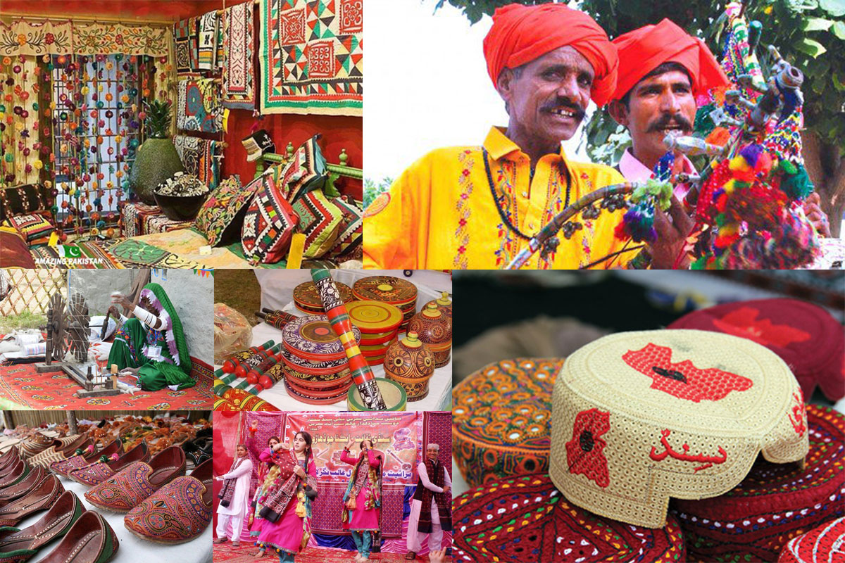
SINDH CULTURE
PRESENTED BY:
Umer Rashid
Muqaddas Ali
Muhammad Abdullah Khan
Muhammad Kamran Ashraf

Slide 2
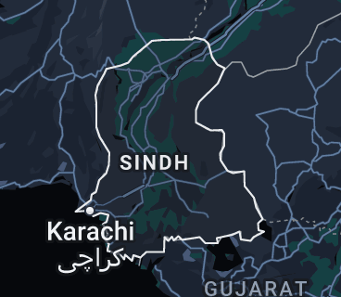
INTRODUCTION
Sindh is one of the four provinces of Pakistan and historical home to sindhi people.
Also known as “Mehran” and has been given the tilte of “Bab-ul-Islam”(The Gateway of Islam),and also called as Indus Valley.
The capital of province is Karachi , the largest city of Pakistan and Financial Hub.
Culturally rich with many forts and other historical buildings.
Muslims in majority, but a very large number of Christians and Hindus.

Slide 3
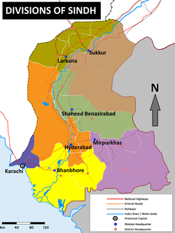
SINDH Geography
In Area (140,914 km²) third largest province of Pakistan.
Population is more then 30.4 million.
Located on the western corner of South Asia.
On East side India and on West side Balochistan province.
On North side Punjab and on South side Arabian Sea.
Sindh is known for its rich history, diverse traditions, and a vibrant blend of cultures.

Slide 4
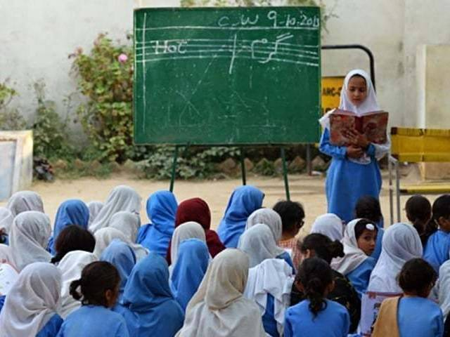
SINDH LANGUAGE
Sindhi is the official language of Sindh and is spoken by the majority of the population.
The Sindhi language is a source of pride for Sindhi speakers . There are many more languages spoken other than the Sindhi like Urdu , Punjabi , Pashto , Balochi etc.
According to the survey in 2017:
59% of people of Sindh speak Sindhi.
28% of people of Sindh speak Urdu.
10% of people of Sindh speak Punjabi.
2% of people of Sindh speak Balochi.
1% of people of Sindh speak Pashto.

Slide 5
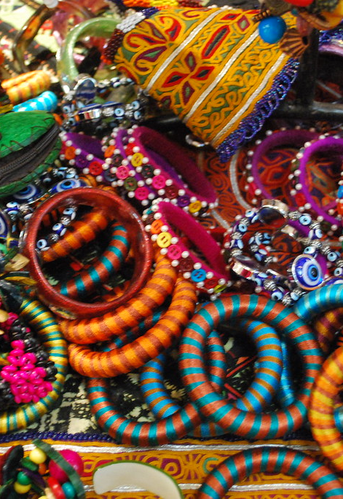
SINDH FESTIVAL
Sindhi Topi Day.(December 06, 2009)
Urs of Shah Abdul Latif Bhittai.
Cheti Chand.
Basant Festival.
Eid-ul-Fitr.
Diwali.
Urs of Lal Shahbaz Qalandar.

Slide 6
SINDHI DRESSES
The Sindhi Topi is a traditional cap worn by men in Sindh. It is an iconic symbol of Sindhi identity.
The traditional attire of Sindhi men includes the "Ajrak" (a printed shawl), "Kurta" (long shirt), "Sindhi Topi" (cap), and "Khes" (wrap-around cloth).
The Chunri is a colorful and patterned dupatta (scarf) worn by Sindhi women.
The Ghagra Choli is a traditional Sindhi dress worn on special occasions and festivals.

Slide 7
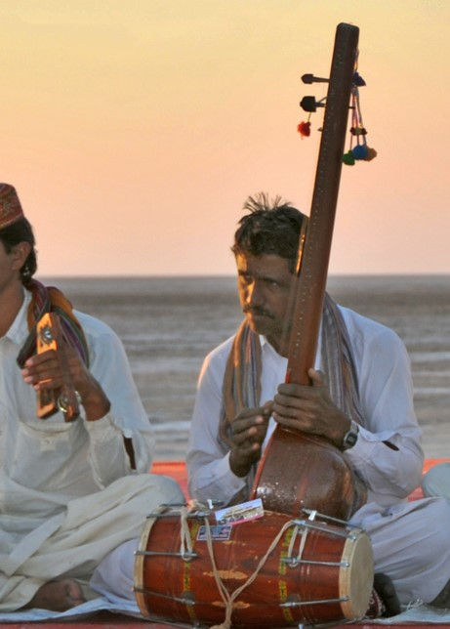
SINDH MUSIC
Traditional Sindhi music a variety of musical instruments, including the Sarangi, Alghoza (double flute), Murli (flute), Been (a string instrument), and Dhambura (drum).
Sindh has a rich Sufi tradition, and Sufi music holds a significant place in Sindhi culture. Qalams (poems) of Sufi saints such as Shah Abdul Latif Bhittai and Sachal Sarmast are set to music and sung with great devotion.
Their famous singers are Abida Parveen, Zarina Baloch, Mai Bhagi , Master Manzoor , Fozia Soomro.
There are many other talented artists who have enriched Sindhi music with their unique styles and voices.

Slide 8
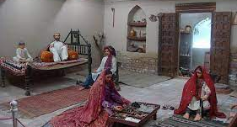
FAMILY SYSTEM IN SINDH
In rural areas of Sindh the family system is mostly joint family.
While in urban area, the families are very less joint.
The people of rural area of Sindh lives is such kind of koti , which they make by their self.

Slide 9
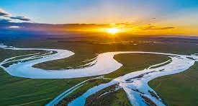
Sindh Rivers
Indus River
Hub River
Malir River
Phuleli River
These rivers not only contribute to the agricultural productivity and water supply in Sindh but also provide opportunities for various recreational activities and support the rich ecosystem of the region.

Slide 10
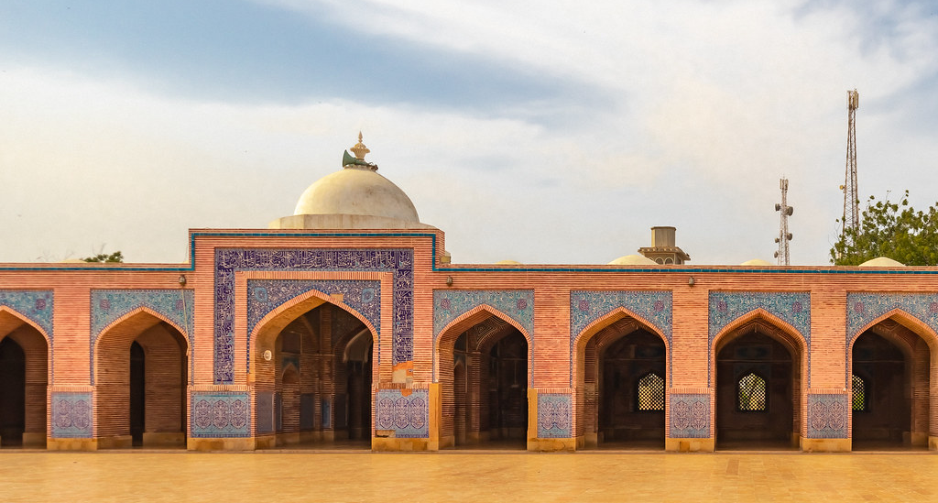
SINDH ARCHITECTURE
Sindh is home to several walled cities and forts that served as centers of defense and trade. For example include the historic cities of Thatta and Hyderabad.
Sindh is home to The Masjid-e-Tooba in Karachi and the Shah Jahan Mosque in Thatta beautiful mosques, showcasing architectural styles.
Shah Jahan Mosque, Thatta Constructed during the reign of Mughal Emperor Shah Jahan in the 17th century, the Shah Jahan Mosque is an architectural masterpiece.

Slide 11
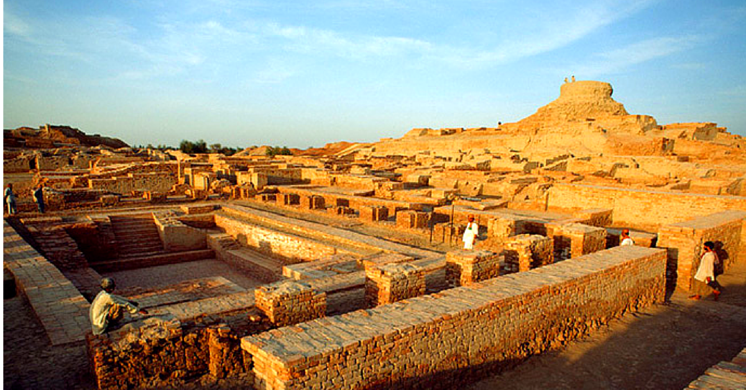
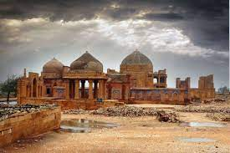
SINDH DISCOVERIES
Moen-jo-Daro or Mohen-jo-Daro
Makli Nacropolis
Bulid around 2600 BCE.
Discover in 1922.
Part of the ancient Indus Valley Civilization.
A Tomb at Makali Hills necropolis Bulit in 1559.
Spread over an area of some 15 Kilometers Houses Millions of graves of Kings and Queens.

Slide 12
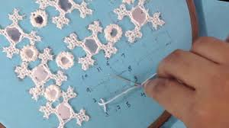
Mirror Work
Mirror work, also known as sheshay ka kaam, is a significant aspect of Sindhi craft.
It involves attaching small pieces of mirrors to fabric or other materials, creating a reflective and dazzling effect.
Mirror work is commonly seen on traditional garments, home decor items, and accessories like bags and footwear.

Slide 13
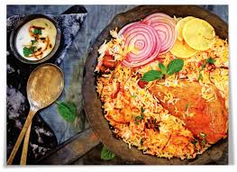
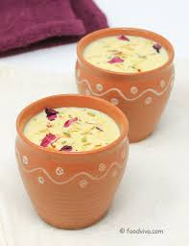
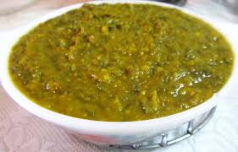
SINDH FOOD
FAMOUS DISHES
DRINKS
Palla machli.
Sindh Biryani.
Naali Biryani.
Pickle.
Desi Chicken.
Daal pakwan.
Palak.
Thadi.
Khirni.
Sharbat.
Falooda.
Lassi.

Slide 14
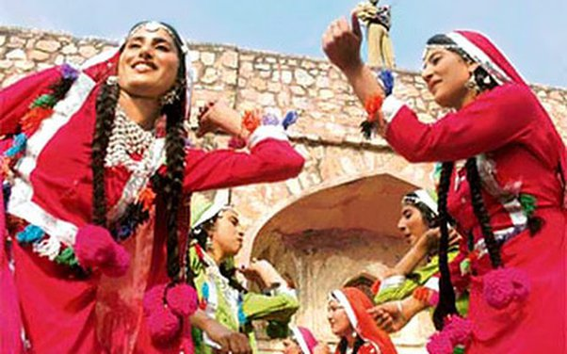
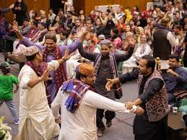
SINDH TRADITIONAL DANCES
Jhoomar
Ho Jamalo.
Dhamal
Luddi
Chhaj
Bhagat

Slide 15
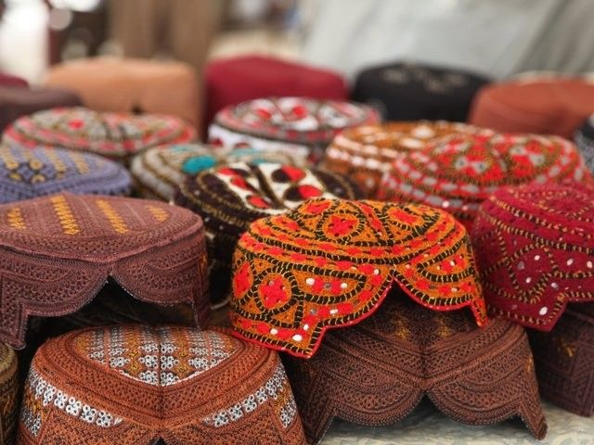
CONCLUSION
The cultural heritage of Sindh is a testament to its rich history, diverse traditions, and resilient people.
By embracing and celebrating its unique identity, Sindh continues to contribute to the vibrant tapestry of Pakistani culture.
Let us appreciate and preserve the treasures of Sindhi culture for generations to come.

